Slide 1
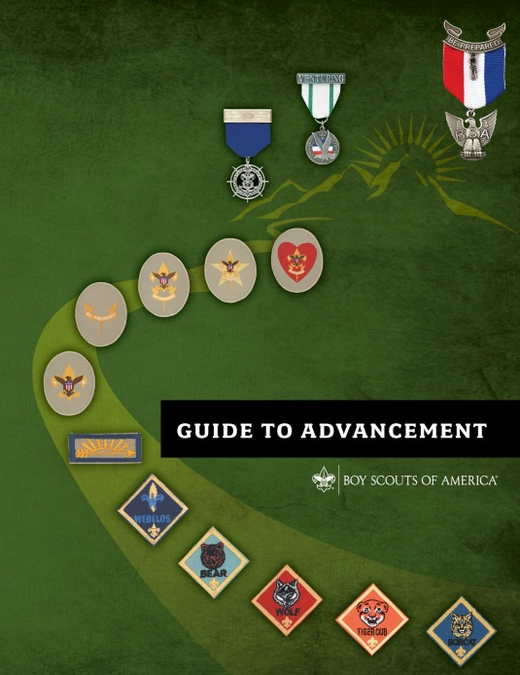
Guide to Scouts BSA Advancement in the Troop for special needs Scouts

Slide 2
Aims of the Scouting Program
Character development
Leadership development
Citizenship training
Personal fitness (mental and physical)
Every activity in Scouting should support
one or more of these aims.

Slide 3
The Goal
An observation:
Practically everything a boy or girl does in Scouting provides an opportunity for learning and growth.
Personal growth is the primary goal.
GtA 2.0.0.3

Slide 4
Methods of Scouting
Scouting ideals
Patrol method
Outdoor programs
Advancement
Association with adults
Leadership development
Uniform
Personal growth

Slide 5
Challenge leads to personal growth
The advancement program is meant to challenge our members; however, not all of them can achieve everything they might want to—with or without a disability.
It is for this reason all Scouts are required to meet the requirements as they are written, with no exceptions.

Slide 6
Main principle: Advancement is based on experiential learning
Everything done to advance is designed to educate or to otherwise expand horizons. Scouts learn and develop according to a standard.
Experiential learning is the key: Exciting and meaningful activities are offered, and education happens. Learning comes from doing. For example, youth may read about first aid, hear it discussed, and watch others administer it, but they will not learn it until they practice it. Rushing a Scout through requirements to obtain a badge is not the goal.
GtA 2.0.0.2

Slide 7
Four Steps in Scouts BSA Advancement
The Scout learns.
The Scout is tested.
The Scout is reviewed.
The Scout is recognized.
(1+ and/or 2+) The Scout uses the skills (opportunities to practice; reinforces the learning; retention through repetition).
GtA 4.2.1.0

Slide 8
Advancement Principles
The Scout must meet the most current requirements for advancement and MBs.
The requirements in effect at the time the Scout begins to complete his/her first requirement for a rank or MB.
The Scout must “show his/her stuff”
The Scout is expected to meet the advancement and MB requirements as they are stated - no more and no less.
He/she must do exactly what is stated in the requirements.
No council, committee, district, unit, or individual has the authority to add to, or subtract from, advancement requirements.
Once tested and signed off, the requirement is earned.

Slide 9
Keeping things in perspective for special needs Scouts
Advancement is a method of scouting, not the mission
What is expected of scouts with and without disabilities
Achievable challenge
All in good time
Comparable challenge
Having fun
The outcomes of the Scouting experience should be fun and educational, and not just relate to completing rank requirements that might place unrealistic expectations on a member who has special needs. GtA 10.2.2.0

Slide 10
Options available for Scouts with special needs and disabilities
Simple accommodations (modifications) to meeting requirements that provide a very similar challenge and learning experience.
Substituting alternative requirements for regular requirements for the ranks of Scout through First Class
Substituting merit badges for badges that are Eagle-required
Getting to remain in Scouts BSA indefinitely (and continue to work on advancement)

Slide 11
What does the unit need to do?
Unit leaders - Think about and plan for how to work with the Scout, given his/her special needs [Be knowledgeable and Be prepared]
Read the Introduction to working with Scouts with special needs and disabilities, No 510-071
Read the applicable sections in the Guide to Advancement, Section 10
Regular involvement with the Scout (consider a mentor or coach)
Have a pre-joining conference
Talk with the Scouts in the unit
Encourage the Scout
Involve the parents or guardians, at least regularly consult

Slide 12
The challenge of timing for special needs Scouts
A Scout is expected to complete every requirement or merit badge possible for a given rank before an alternative rank requirement or merit badge can be formally approved.
In general, a Scout is not allowed to attempt to complete an alternative requirement or merit badge until after the alternative has been formally approved.

Slide 13
What are the steps for ranks of Scout, Tenderfoot, Second Class, and First Class? [ 1 of 2]
Complete as many of the requirements as possible
May involve simple accommodations (modifications) to meeting requirements that provide a very similar challenge and learning experience. Unit leaders should agree in advance on these accommodations.
Once the Scout’s best has been done to the limit of the Scout’s abilities and resources, submit to the council advancement committee a written request for alternative requirements.

Slide 14
What are the steps for ranks of Scout, Tenderfoot, Second Class, and First Class? [ 2 of 2]
Request should include:
A specific request from scoutmaster or committee chair.
A letter from a parent, guardian, or Scout petitioning the Scout council for the exception.
A supporting letter from the unit leader that endorses the request for an exception.
A letter of explanation from the Scout directly (when possible).
A completed medical form.
A written statement from a qualified health professional.
Copies of existing plans for treatment or accommodations are not mandatory, but can help.

Slide 15
What are the steps for alternate merit badges for MBs that are Eagle required? [ 1 of 2]
Note:
Individual requirements for a MB may not be changed or substituted.
May only request an alternative MB.
Earn as many Eagle-required MBs as possible.
Like rank requirements, may involve simple accommodations (modifications) to meeting requirements.
Exception: situations where the need for an alternative is obvious. Then, must earn First Class rank first.
Once the Scout’s best has been done to the limit of the Scout’s abilities and resources, submit to the council advancement committee a written request for alternate MBs. Note: MBs already earned may not substitute.

Slide 16
What are the steps for alternate merit badges for MBs that are Eagle required? [ 2 of 2]
Request should include:
Application for alternative Eagle Scout rank merit badges.
A letter from a parent, guardian, or Scout petitioning the Scout council for the exception.
A supporting letter from the unit leader that endorses the request for an exception.
A letter of explanation from the Scout directly (when possible).
A completed medical form.
A written statement from a qualified health professional.
Copies of existing plans for treatment or accommodations are not mandatory, but can help.

Slide 17
Resources available
Use the council’s advancement section on the council’s website as a go-to source for information and required documents
susquehannabsa.org/advancement
Guide to Advancement, Section 10.0.0.0
Introduction to working with Scouts with special needs and disabilities, No 510-071
The inclusion toolbox
Individual Scout Advancement Plan, No 512-96
Alternative requirements – summary of procedures to apply
Application for alternative Eagle Scout rank merit badges

Slide 18
A word about time – It Takes Time
Once a Scout reaches the rank of First Class, each Scout needs to be coached repeatedly on the time it will take to complete the requirements for Star, Life, and Eagle. It is an opportunity to reinforce the life lesson of planning ahead.
Major points to reiterate with the Scout:
Each of these ranks has a non-negotiable minimum period to be active in the troop and serve in one or more specified position of responsibility.
Meeting some requirements for rank advancement and MBs will take longer than expected.
The Scout will have to balance time available to work on advancement and MB requirements with commitments to other aspects of his life (family, school, sports, other activities, other interests, work).
At times, the Scout will have to adapt to the schedules of others.
For the best experience, a Scout should earn the Life rank before turning 17.

Slide 19
Questions??

Slide 20
Advancement Functions
Planning
Preparation
Teaching or training (Learning)
EDGE
Testing
Recording
Reviewing
Recognizing

Slide 21
Advancement Roles
Scoutmaster
Assistant Scoutmasters
Committee chair
Advancement coordinator
Committee members
Youth leaders (SPL, ASPL, PLs, Troop Guide, Junior Asst SM)
Chartered Organization Rep
Each troop needs to decide the role each position will be play in performing the advancement functions, as well as the expectations and procedures.

Slide 22
Digging into a few advancement requirements
Demonstrate Scout Spirit
GtA 4.2.3.2
Service Projects
GtA 4.2.3.3
Unit leader (Scoutmaster) conference
GtA 4.2.3.5
Active participation (Star, Life, Eagle)
GtA 4.2.3.1
Positions of responsibility (Star, Life, Eagle)
GtA 4.2.3.4

Slide 23
Merit Badges GtA 7.0.0.0
Should always start with meeting with the unit leader for every MB
“the leader’s opportunity to give guidance on the wisdom of pursuing a selected badge, to advise the Scout on how work might be approached, and what may be encountered along the way.
… also the time to provide the names and contact information for one or more approved counselors.
The best outcome is that a growth-oriented, positive dialog occurs that provides inspiration and direction in a Scout’s life and even leads to conversations about talents and interests, goal setting, and the concept of “challenge by choice.”
Encourage interaction and association with adults outside the troop
Workbooks – can not require and have limited use in meeting requirements

Slide 24
Boards of Review (1 of 2) GtA 8.0.0.0
Composition
The board is made up of three to six unit committee members—no more and no less. In units with fewer than three registered committee members available to serve, it is permissible to use knowledgeable parents (not those of the candidate) or other adults (registered or not) who are at least 21 years of age and who understand Scouting’s aims. Using unregistered adults for boards of review must be the exception, not the rule.
GtA 8.0.2.0
Unit leaders and assistants shall not serve on a board of review for a Scout in their own unit. Parents, guardians, or relatives shall not serve on a board for their child. The candidate or the candidate’s parent(s) or guardian(s), or relative(s) shall have no part in selecting any board of review members.
GtA 8.0.0.3
The Unit leader may be present to observe.
GtA 8.0.1.0

Slide 25
Boards of Review (2 of 2) GtA 8.0.0.0
Conducting the board
“… it should, … , be a celebration of accomplishment. Remember, it is more about the journey. “
Not a retest or “examination”
GtA 8.0.1.1
What should be discussed.
GtA 8.0.1.2

Slide 26
Some best practices
Use the council’s advancement section on the council’s website as a go-to source for information and required documents
susquehannabsa.org/advancement
Establish some advancement policies and procedures for the troop
Assign unit leaders as a mentors for each rank to monitor and encourage progress, including information and guidance to move forward
Reinforce learning from completion of advancement requirements through troop activities
Units should plan for timely opportunities to review (BoRs) and recognize (CoHs) the advancement achievements of the Scouts

Slide 27
Worksheets and Learning Aids
Merit badge “worksheets” from the Web or other sources are unofficial, but may aid in learning.
These tools must relate to current BSA requirements, which still must be fulfilled as written.
Worksheets may be used to meet “in writing” requirements.
Worksheets are not a substitute for “telling,” “showing,” or “demonstrating,” etc.
Scouts must not be required to use them.
Guide to Advancement topic 7.0.4.8
Notes:
Worksheets and other materials that may be of assistance in earning merit badges are available from a variety of sources including the Internet and troop libraries. Use of these aids is permissible as long as they can be correlated with the current requirements. Completed “worksheets” may suffice where a requirement calls for something in writing, but they do not work as substitutes where Scouts must discuss, tell, show, or demonstrate something.
The Boy Scouts of America does not currently produce any worksheets or other similar learning aids for merit badges simply due to the costs and additional effort related to keeping them up to date. The National Advancement Team, however, recognizes the value of such tools, and permits their use as long as merit badge counselors and unit leaders understand this is not official material and that use of the tools must not serve to alter merit badge requirements or provide unauthorized shortcuts. Scouts are still expected to complete all the official requirements as written.
It is important to note that regardless of the value of these worksheets or other learning aids, Scouts must not be required to use them.

